Slide 1
Thermal Distribution in a Pack of Cylindrical Batteries
COMSOL

Slide 2
Introduction
This example demonstrates how to model the temperature distribution in a battery pack during a 4C discharge
The pack is constructed by first coupling two cylindrical batteries in parallel
Six parallel-connected pairs are then connected in series to create the full pack — a configuration also called 6s2p
This configuration for the lithium ion battery pack is quite common in portable devices like skateboards, toys, drones, and medical equipment
The symmetry of the problem is used twice so that only the temperature distribution for three batteries needs to be solved for

Slide 3
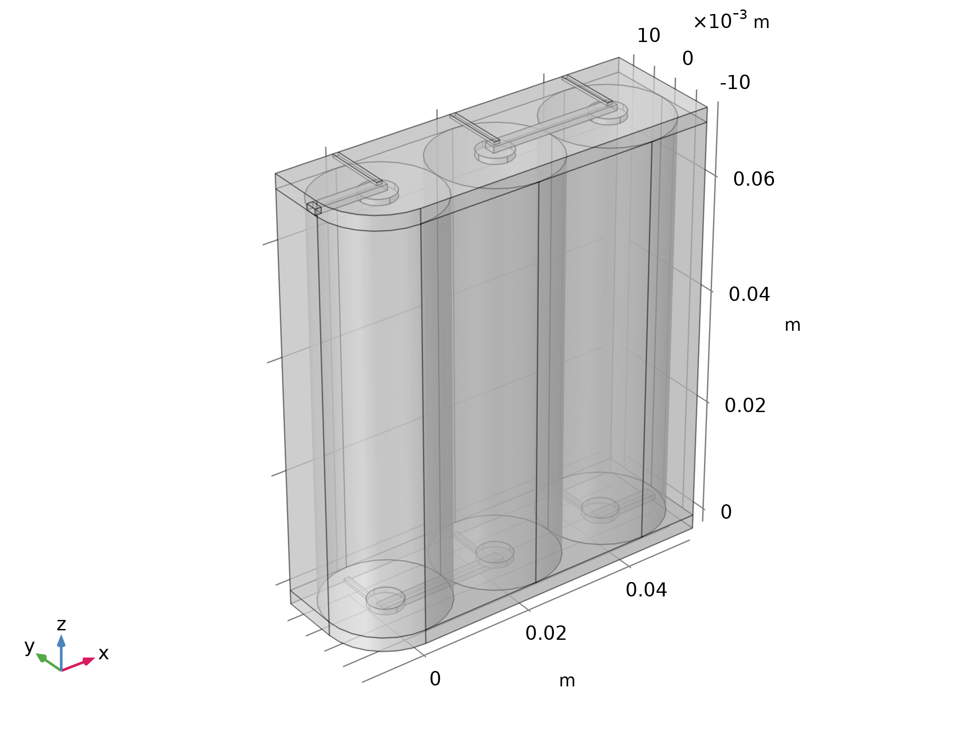
Model Definition
The figure shows the model geometry
Three 21,700 battery cylinders (21 mm in diameter, 70 mm high) are placed adjacent to each other
Small connecting strips of aluminum are located at the top and bottom of the cylinders according to the 6s2p configuration
The whole pack is assumed to be wrapped in plastic, forming a domain filled with air
Geometry 1

Slide 4
Model Definition
Assuming a nominal capacity of 4 Ah for each cell and nominal voltage of 3.7 V, the battery pack has a total nominal capacity of approximately 178 Wh
Geometry 1

Slide 5
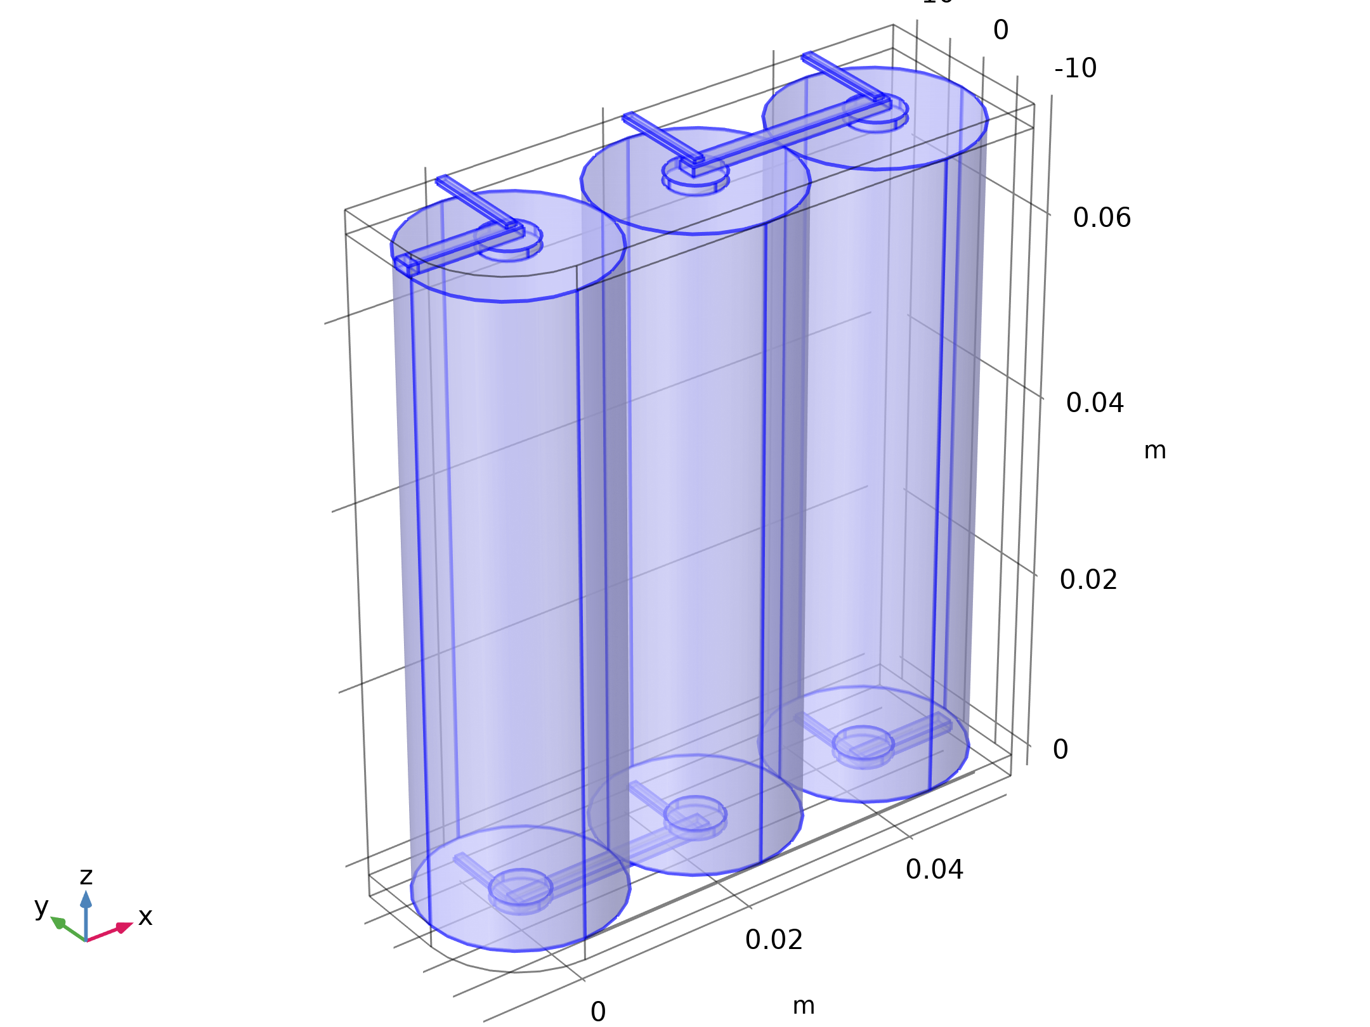
Model Definition
Battery Pack

Slide 6
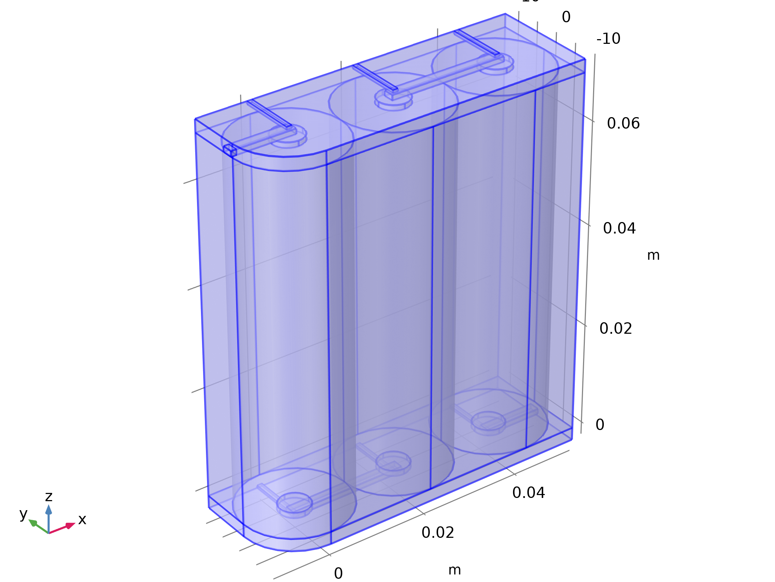
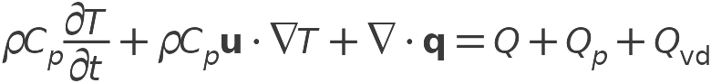

Model Definition
Heat Transfer in Fluids

Slide 7
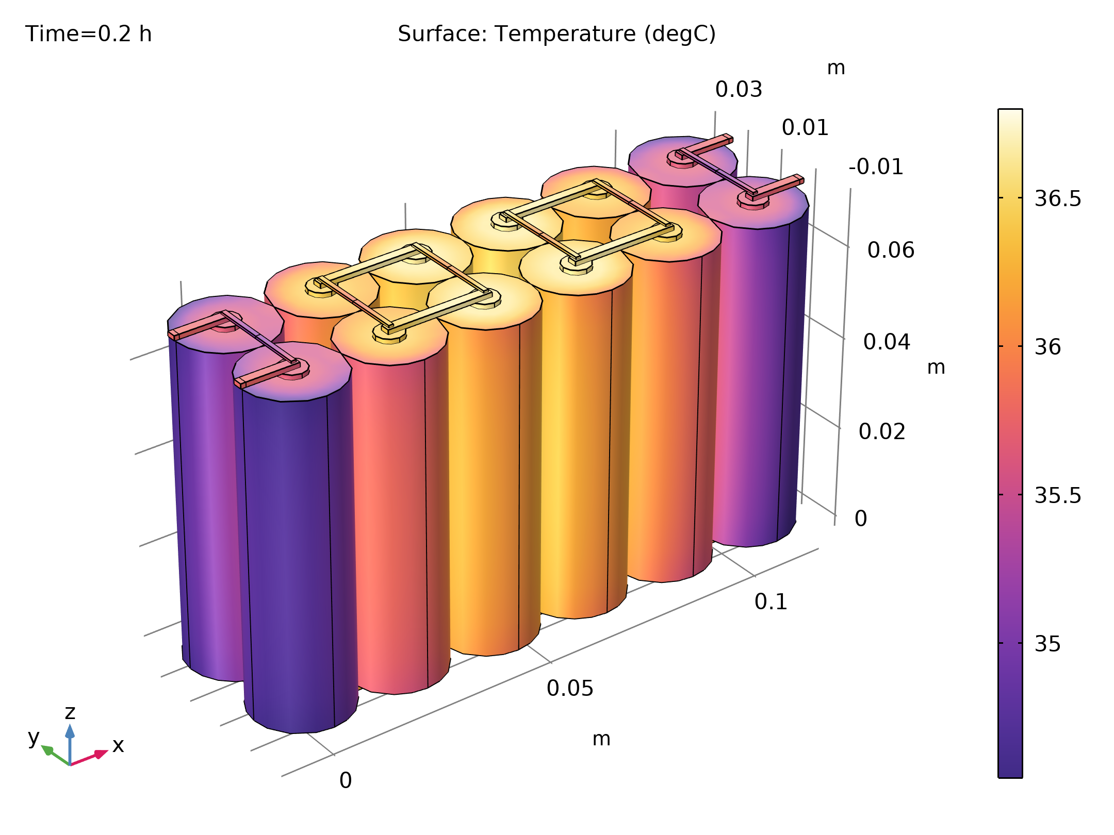
Results
The figure shows the temperature distribution in the pack at the end of the simulation, where the solution data has been mirrored twice to illustrate the temperature of the full 6s2p pack
The innermost parts of the pack experience a temperature about 2ºC higher than the outermost parts
Temperature plot at t= 0.2 h

Slide 8
Results
The figure shows a plot of the individual cell voltages during the discharge
The outermost cell (Cell 1) exhibits a slightly lower discharge voltage, a result of the ohmic drop and
exchange current being slightly lower, and the diffusion time constant slightly higher, for the lower temperature, but the effect is small
Cell voltages versus time

Slide 9
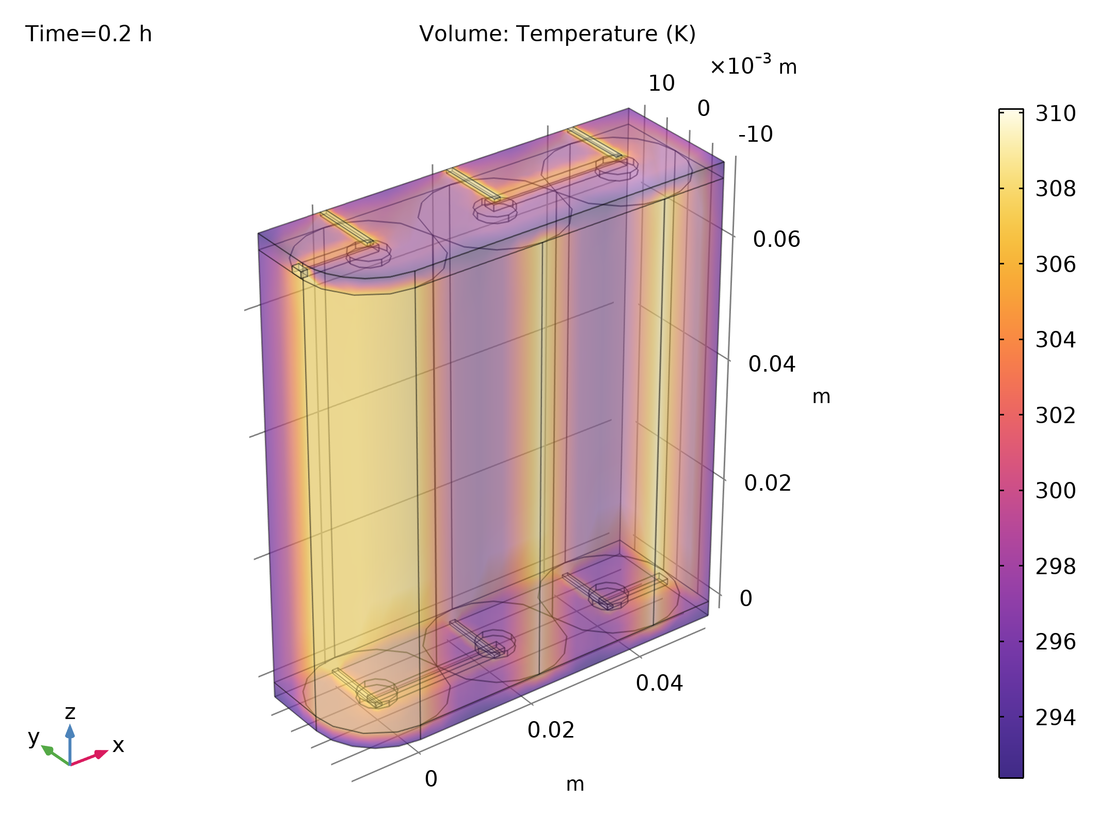
Results
The corresponding temperatures are shown in the graph as in the previous graph

